Slide 1



Analysis
$$\&$$
Devi Somalinga Bhuvanesh
Gurrup Kaur Gurbir Singh Soi
Vy Hoang Mai Duong
Notes:
Analysis of songs can provide valuable insights into the music industry and consumer preferences, making it a crucial field of study. Understanding the characteristics that make a song popular, such as the tempo, valence, and energy, can help music producers and marketers create music that appeals to consumers
Nowadays, Spotify and YouTube are considered among the most known platforms for distributing and consuming music and video content globally. By analyzing the mainstream content on these two platforms, music industry professionals can also gain insights into the music consumption habits of consumers.

Slide 2
Report Summary
Exploratory Analysis &
Data preparation
20,718 rows - 28 columns
Songs, Artist, Albums, Channels
Combine and delete variables
Duplicated, Missing values, Outliners & New Variable Column
Preliminary Analysis
Features of Songs, Artists, Albums and Channels
Analysis & Modelling
Logistic Regression & Confusion matrix
Linear Regression & Correlation Matrix
t-test of dependence samples
2 Regression models
Corr Matrix
Confusion Matrix
& T-test
Conclusion and Recommendations
Proposals based on Analysis and Conclusion
Notes:
The project analyses the characteristics of various songs from different artists worldwide, including several statistics of the audio version on Spotify and the official music video of the song on YouTube.
There are 28 variables provided for each of 20,718 songs, including the name of the song, artist, album, danceability, energy, key, loudness, speechiness, acousticness, instrumentalness, liveness, valence, tempo, duration, number of streams, YouTube video information such as title, channel, views, likes, comments, description, licensed, and official video.
Performing Exploratory data analysis, Correlation matrix, Regression, Confusion matrix and t-test

Slide 3
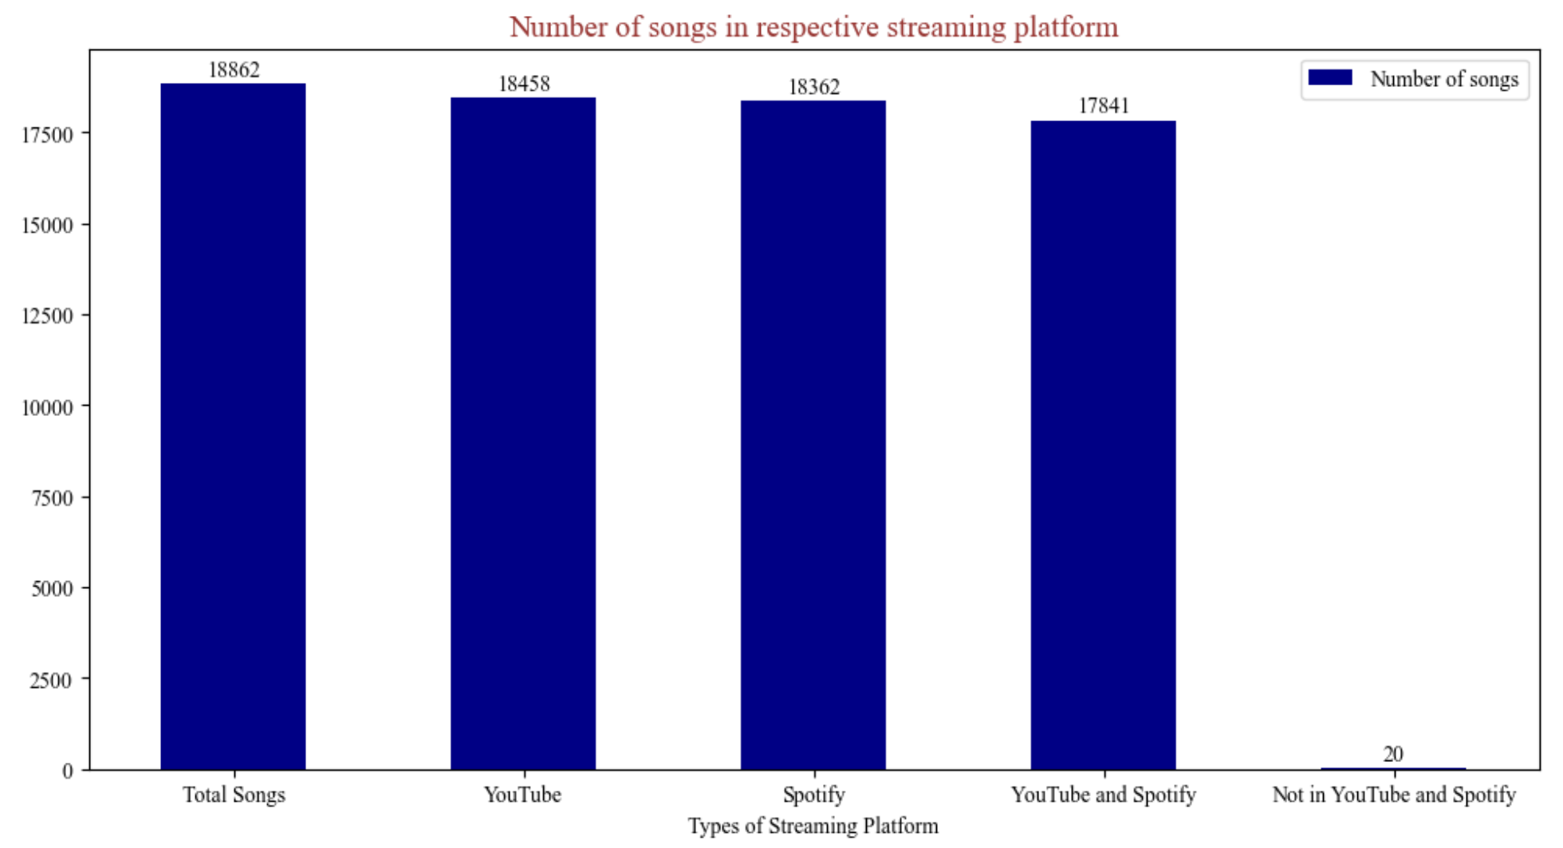
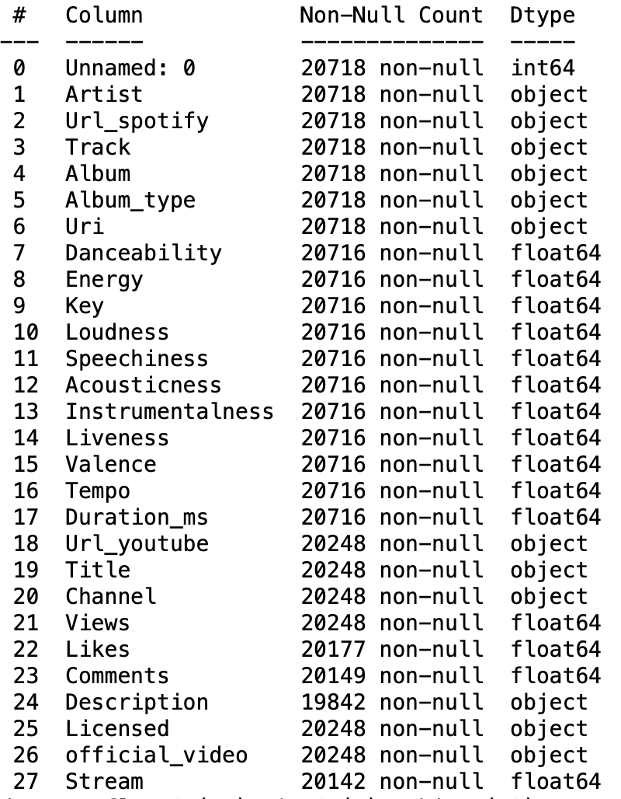
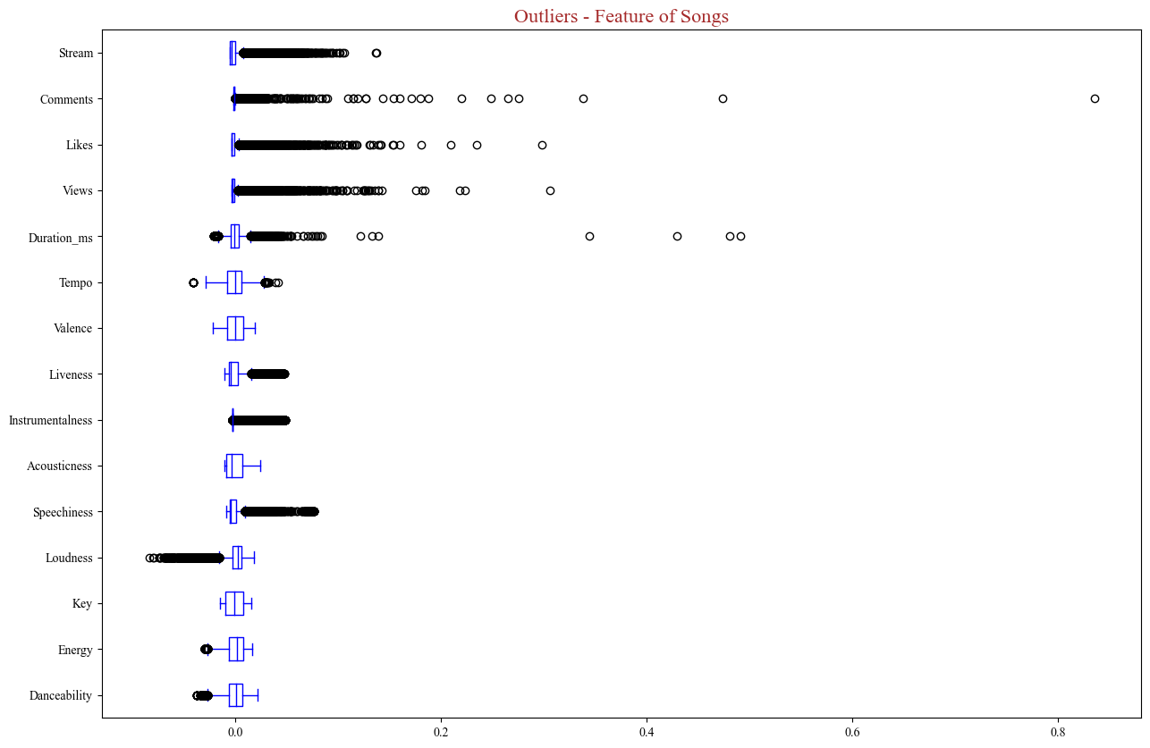
Exploratory Analysis & Data preparation
Rename & Remove columns
Identify duplication and merge values
Define Outliers
Notes:
Dataset was obtained from the Kaggle platform on April 19th, 2023 and was collected on February 7th, 2023. Data is time sensitive
Drop: index, Url_Spotify, and Url_Youtube columns
Missing: 404 tracks out of 18,862 were not on YouTube, as indicated by missing data in fields such as "Title," "Channel," "Views," "Licensed," and "Official Video." Out of the 18,458 videos available on YouTube, 69 do not have information on likes, 96 do not have comments, and 384 do not have a description. Additionally, 550 out of the 18,862 songs are not present on Spotify.
Outliers: highest number of outliers is Instrumentalness, with 4022 songs having values that deviate significantly from the rest. Speechiness (2405), Views (2378), Comments (2355), Likes (2336), and Stream (2011) follow as the next five features with a high number of outliers. The least number of outliers were found in Tempo (57) features of the songs, followed by Danceability (213) and Energy (281)

Slide 4
Exploratory Analysis & Data preparation
Add column Likes-Views ratio for YouTube videos
To indicate the popularity of a songs with the positive reception of that song
Multiple artists performed the same song resulting in duplication of rows with the same song and its features. => Artists set
Divide datasets into 2 sets according analysis purposes
The same song/track was performed by different artists but had different features => Songs set
Notes:
Uri’ column is to identify the uniqueness of the song/track and its feature of the song, so it is used as identifier in merged_track_data set
The other dataset used artist as identifier

Slide 5
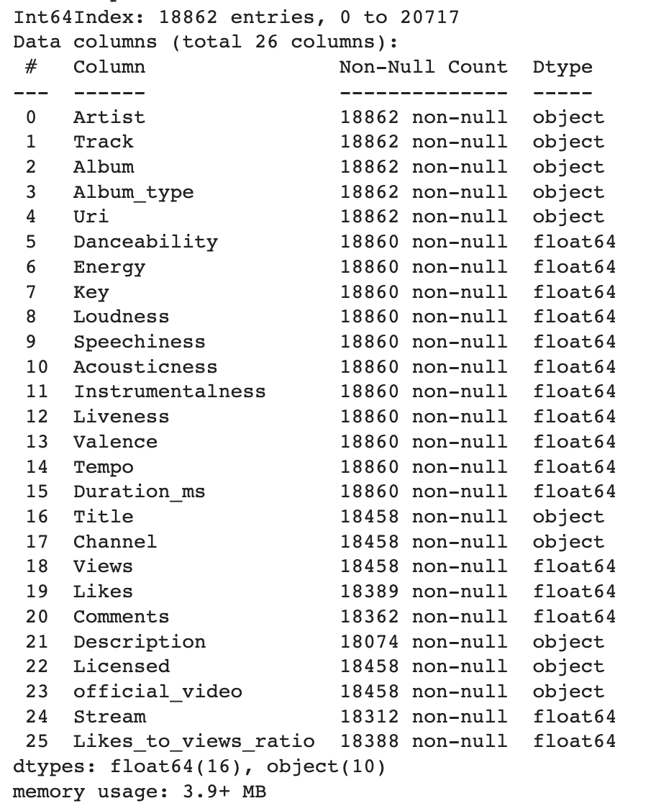
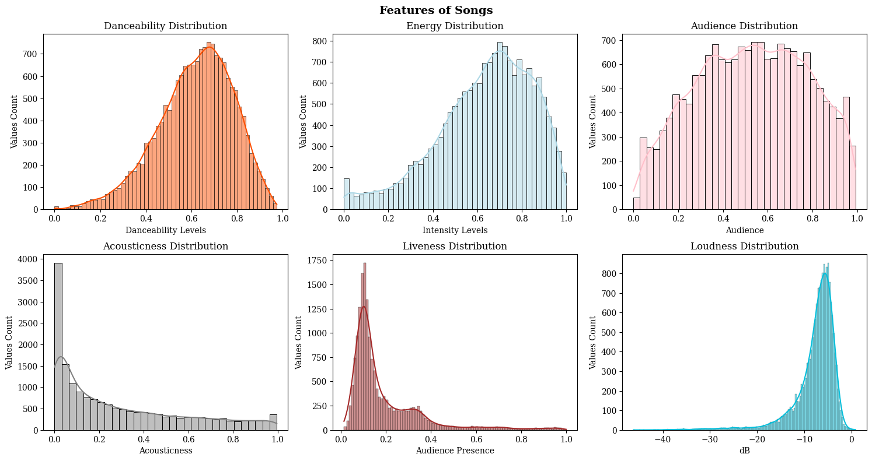
Glimpse of the Cleaned Dataset
Notes:
After cleaning, the dataset is ready for analysis

Slide 6
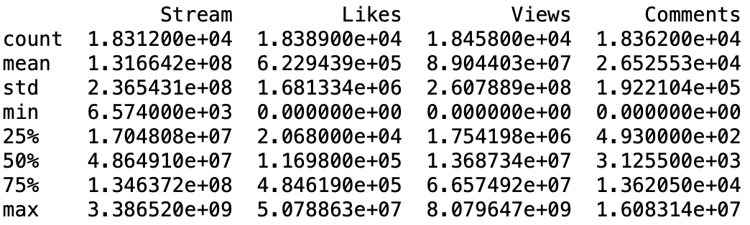
Preliminary Analysis
Spotify Streams peak at ~3.4 billion counts, average stream counts of 18,312 tracks is 131,664,214.
YouTube Views peaks at 8.9+ billion counts, averaging at 89,044,026 which is less than Spotify average stream counts.
+ Views and Comments are indicators of YouTube
01
02
Artists on Spotify & YouTube
Channels & Albums on Spotify & YouTube
03
Songs on Spotify & YouTube

Slide 7
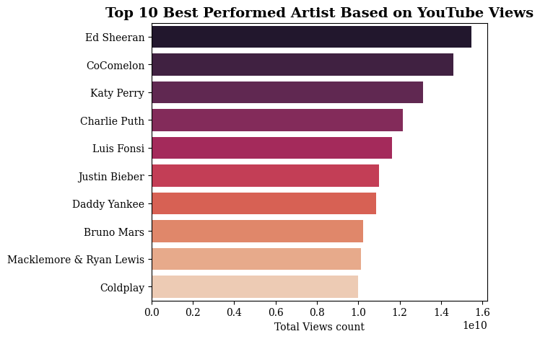
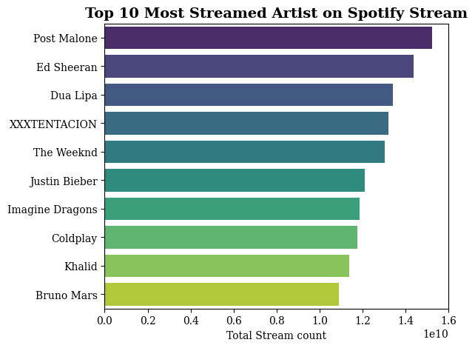
Preliminary Analysis
Top Artists on Spotify & YouTube
Bruno Mars
Coldplay
Ed Sheeran
Justin Bieber
Best Performed Artist on YouTube is Ed Sheeran with an accumulated 15.5 billion views count for all his Songs
In second place is CoComelon, a channel dedicated to children's content, with 14,6 billion views count
Post Malone is the most successful artist on Spotify with ~15.3 billion streams in total.
In second, is Ed Sheeran with 14.4 billion streams
Notes:
Note: Bigger fonts

Slide 8
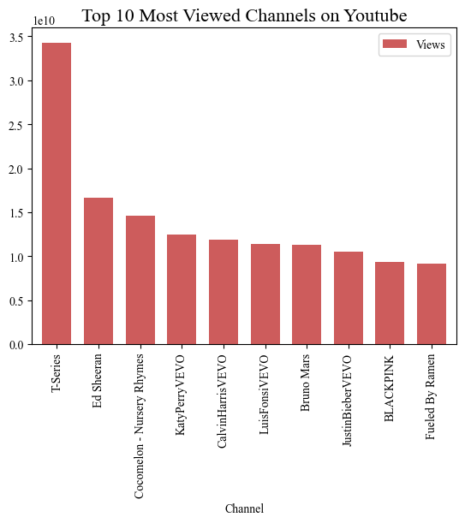
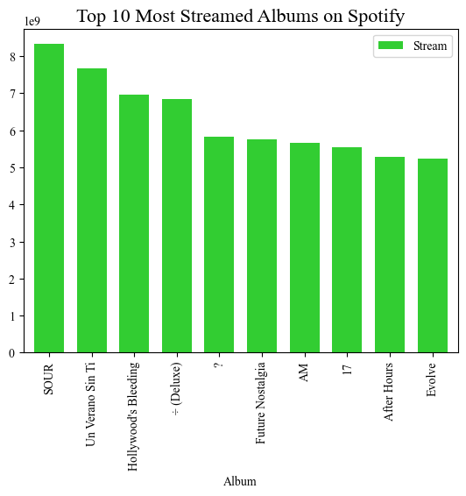
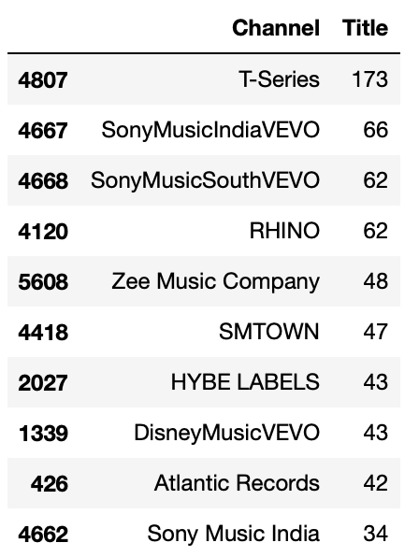
Preliminary Analysis
Top Channels & Albums on Spotify & YouTube
Entertainment companies are taking advantages of YouTube platform to reach more audience
Channel with most uploads are all Entertainment Music companies.
(*At time of data collected)

Slide 9
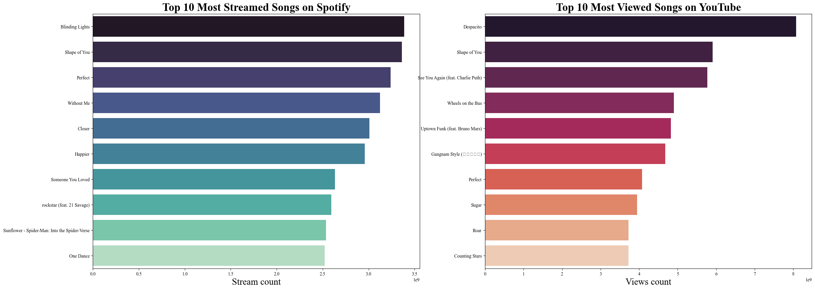
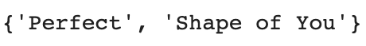
Preliminary Analysis
Top Songs on Spotify & YouTube
2 songs that make it to the Top 10 played in 2 platforms, both from Ed Sheeran:

Slide 10
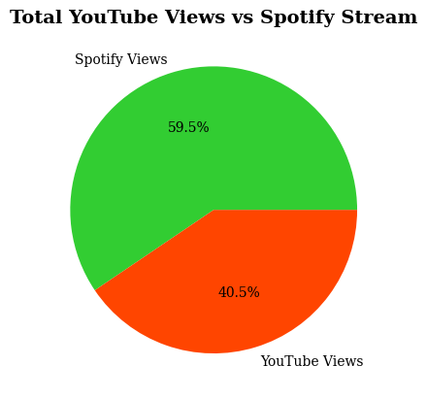
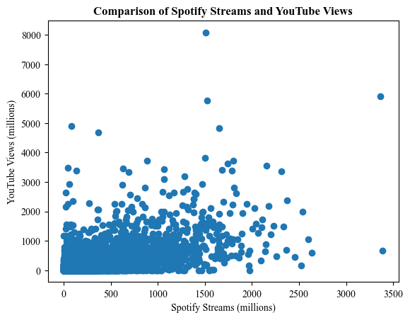
Preliminary Analysis
Total YouTube Views and Spotify Stream
Generally, Spotify total views is higher than YouTube total views in this dataset
Spotify views and YouTube views has a moderately positive correlation of 0.60.
Notes:
Edited in millions

Slide 11
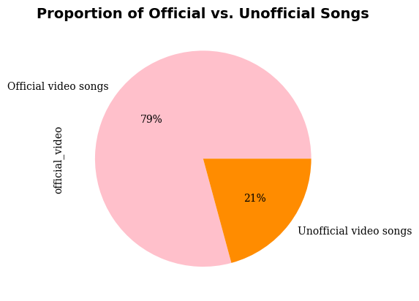
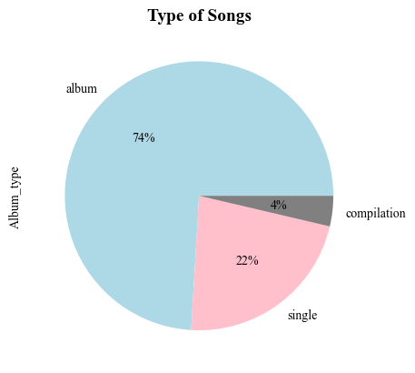
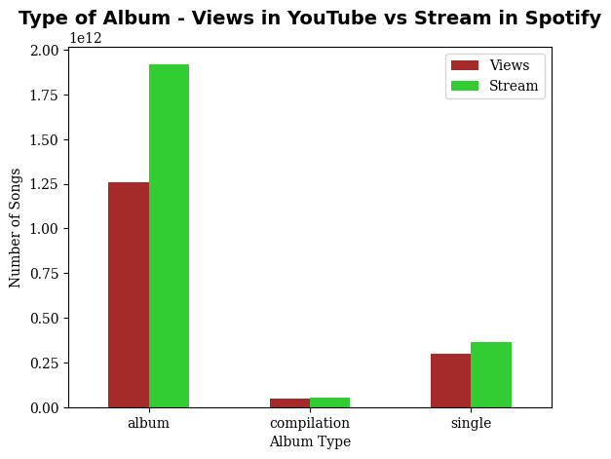
Preliminary Analysis
Songs & Albums on Spotify & YouTube
Most videos on YouTube are official videos (79%)
21% is unofficial uploads
74% songs belong to albums
22% songs are singles
4% are compilation
Spotify has more streams than views on YouTube for each album type

Slide 12
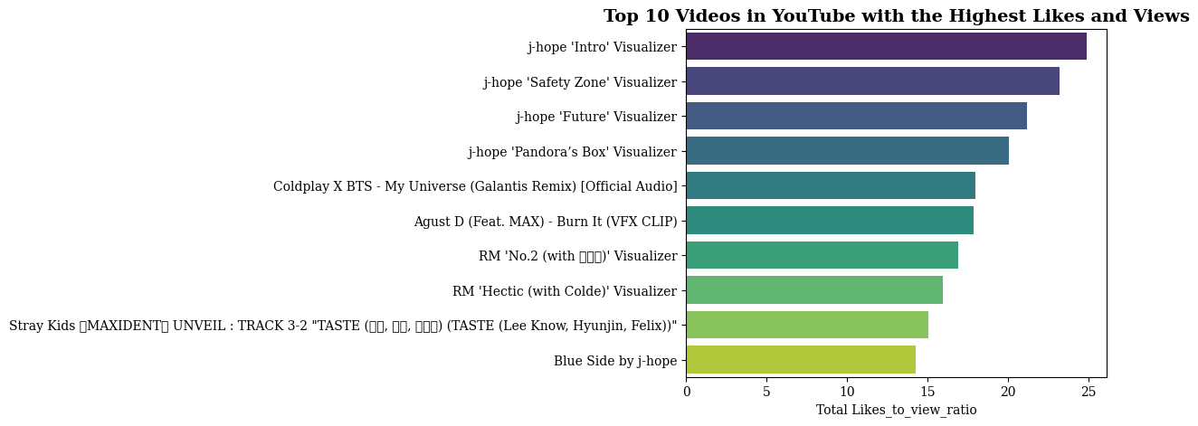
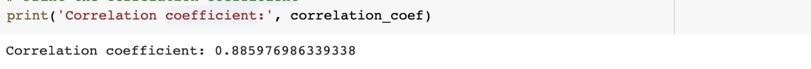
Preliminary Analysis
Gauge of how much an audience is watching and appreciating a video.
A glimpse of trendy music consumption can be seen:
This period favor B.T.S boyband as 8 of the top videos had their members appearance (RM, J-Hope or all group)
The top 4 Likes/Views videos were all from J-hope, a B.T.S member, ranging from 24.92% to 20.05%, followed is Coldplay X BTS.
'Likes' and 'Views' have a significant positive linear association (coefficient of 0.886). This indicates that a rise in views is related to an increase in likes, and vice versa.
Top Likes-Views ratio videos

Slide 13
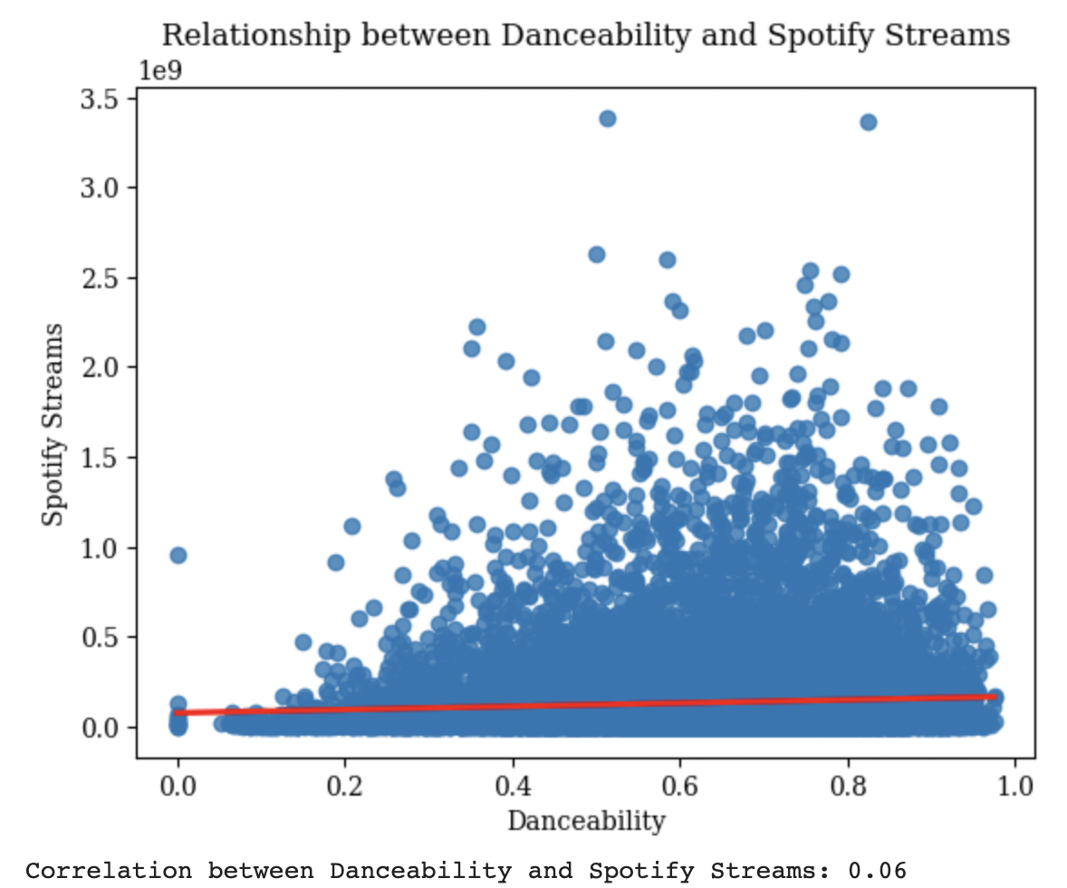
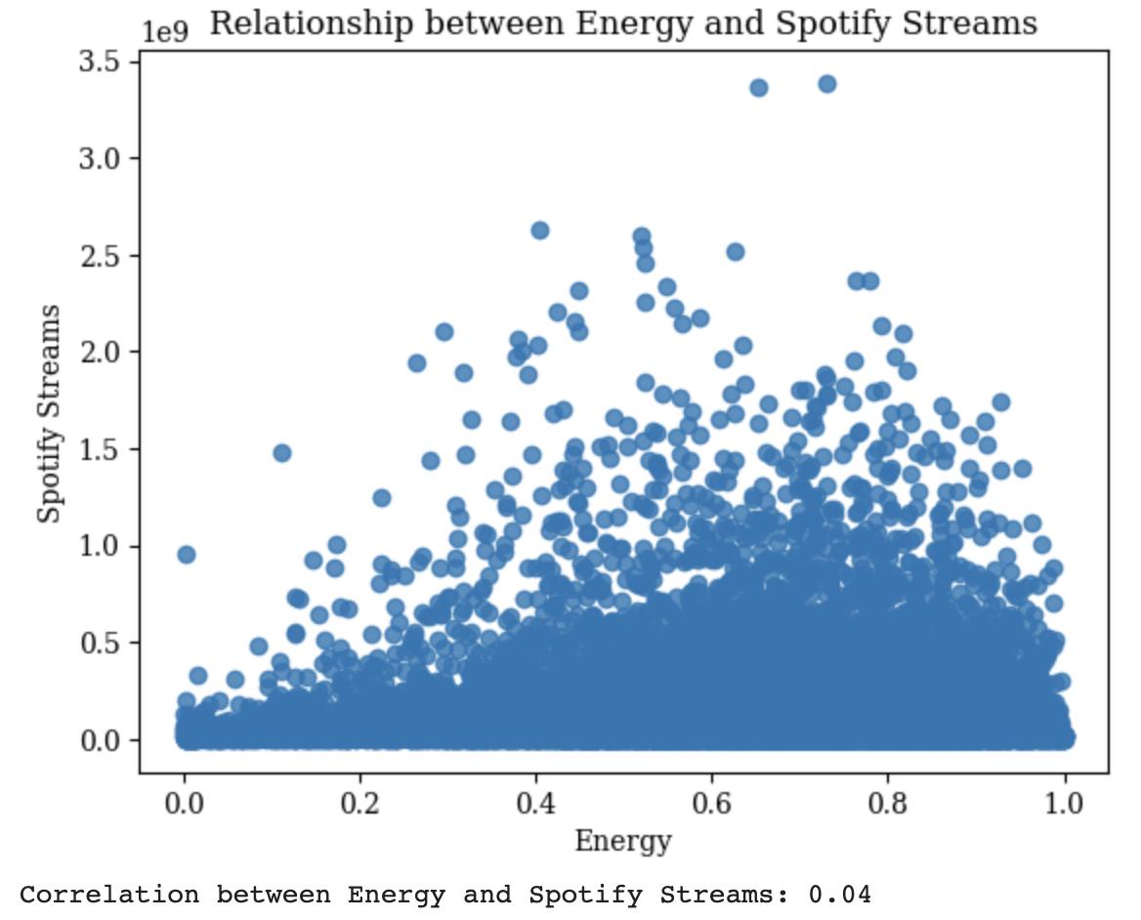
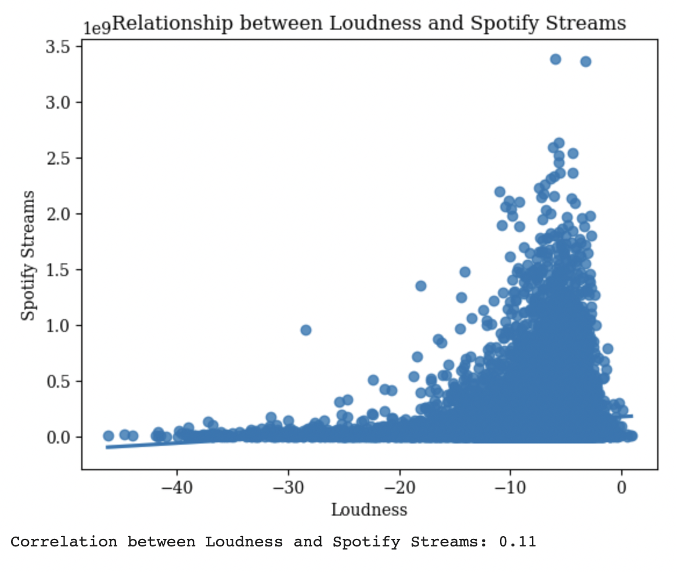
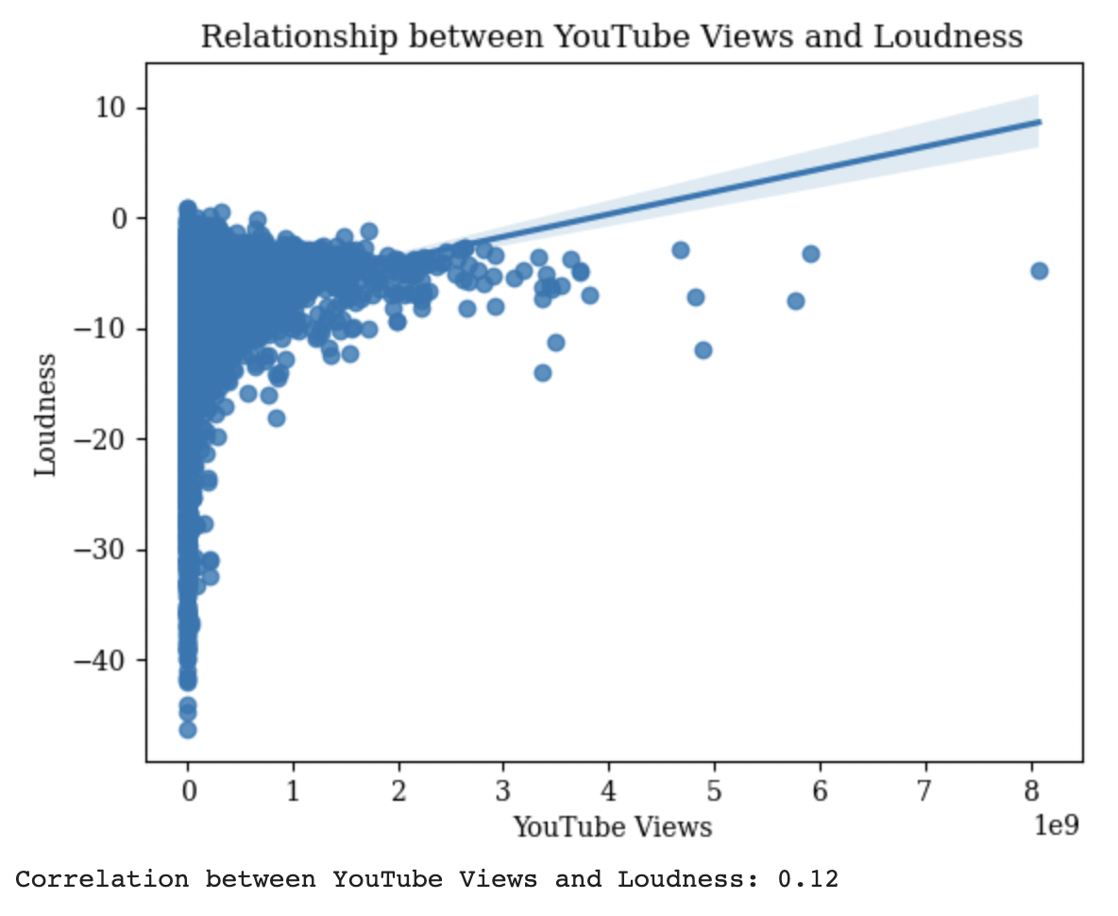
Preliminary Analysis
Linear Relationship
Danceability and Spotify streams have a 0.06 correlation coefficient, which suggests a marginally favorable association
A very slight positive link between energy and Spotify streams—with a correlation coefficient of 0.04—can be seen.
Spotify streams and loudness have a weakly positive correlation (0.11),
The correlation coefficient between YouTube views and loudness, which is 0.12, also shows a weakly positive association between the two variables.

Slide 14
Inferential Analysis & Prediction Modelling
01
02
03
Logistic Regression
Linear Regression
Paired t-test
Analyze the effect of licensing on views:
Number of views: predictor
Whether a song is licensed or not: response variable.
Relationship between the song characteristics and their popularity
Prediction modelling the song’s popularity based on songs characteristic
To infer if there is a significant difference between Spotify Streams and YouTube Views from this dataset sample
Notes:
the question that needs to be answered

Slide 15
Inferential Analysis
Paired test: YouTube Views and Spotify Stream
The question:
Artists and Entertainment companies might be interested in if there is a significant difference between Spotify Streams and YouTube Views.
The method: t-test of dependence samples (Given same artists and songs, different platform)
Conducting the test:
Hypothesis stating:
𝑁𝑢𝑙𝑙 𝐻𝑦𝑝𝑜𝑡ℎ𝑒𝑠𝑒𝑖𝑠 is assuming the Views and Streams of the artists are equal: H0: M1 = M2
The 𝑎𝑙𝑡𝑒𝑟𝑛𝑎𝑡𝑖𝑣𝑒 ℎ𝑦𝑝𝑜𝑡ℎ𝑒𝑠𝑖𝑠 would be that the 2 means are not equal as stated in the null hypothesis: H1: M1 != M2
Test Result:
The test statistic and p-value is -15.363285756565345 and 1.781, which are very large t-statistics (assume alpha=0.01)
The Conclusion: we will reject the Null hypothesis and conclude that there is a significant difference between the reception Artists receive on YouTube and Spotify

Slide 16
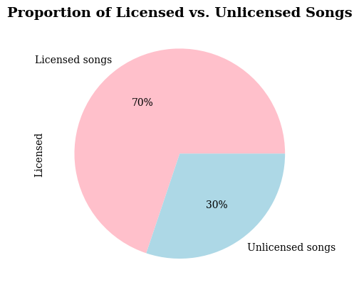
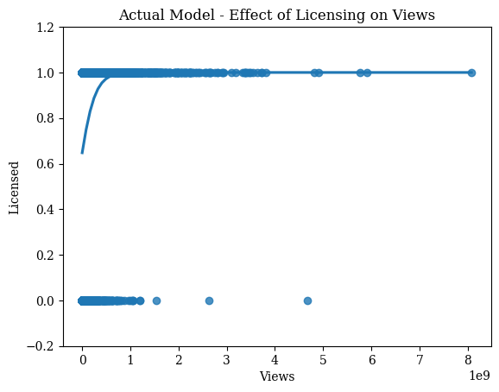
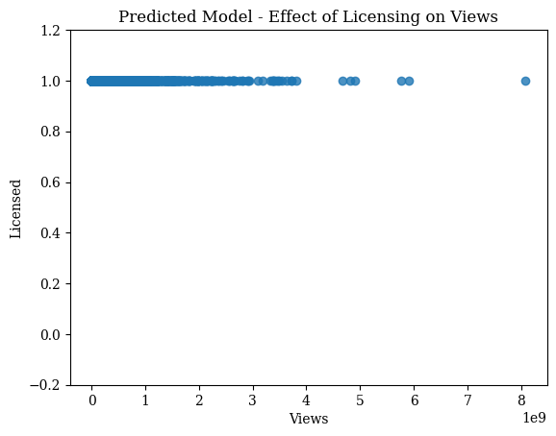
Prediction Modelling
01
Logistic Regression
The dataset has a greater proportion of licensed songs compared to unlicensed ones
Logistic regression model was used to analyze the effect of licensing on views (category variable):
Number of views: predictor variable
Whether a song is licensed or not: response variable

Slide 17
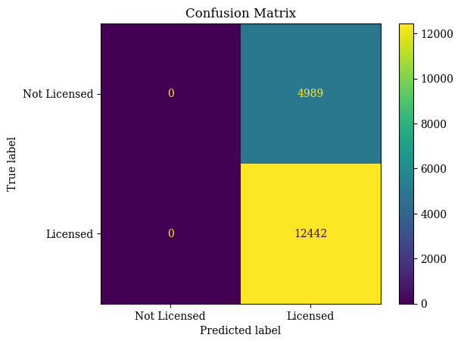
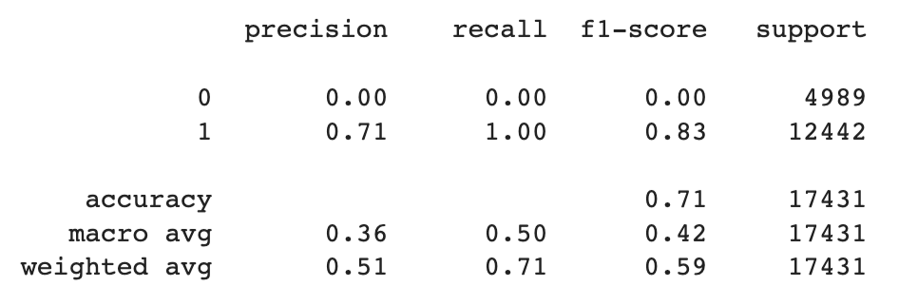
Prediction Modelling
01
Logistic Regression
Precision: from all the True-Positive predicted, 71% was actually licensed.
Recall: in all the licensed songs, we predicted correctly 100%
Accuracy: total accurate predictions was 71%

Slide 18
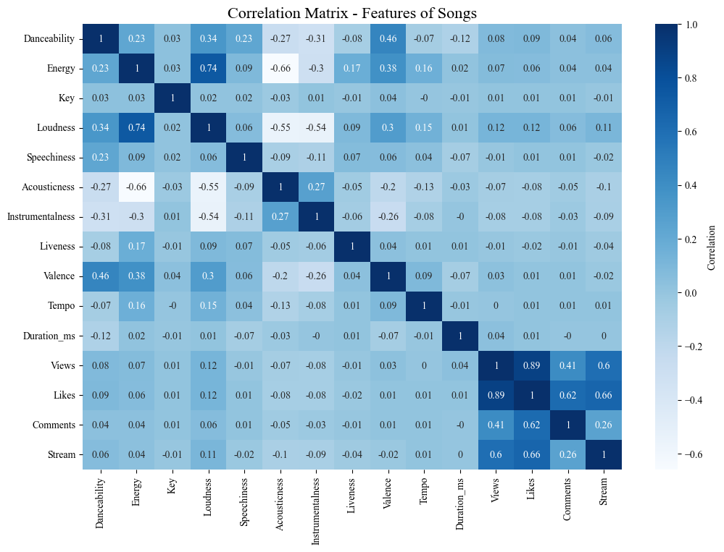
Prediction Modelling
02
Linear Regression
The question:
Uncovering if the more catchy, more danceable, or faster, etc. a song is, the easier it is to be well-received by population
The method: Multi Linear Regression
From correlation matrix, we attempt to modeling YouTube Views prediction and Spotify Streams based on songs features
(Note: exclude attributes with less than 0.05 correlation with the dependent variables
Model was built on train data (70%) and concluded on test data (30%)

Slide 19
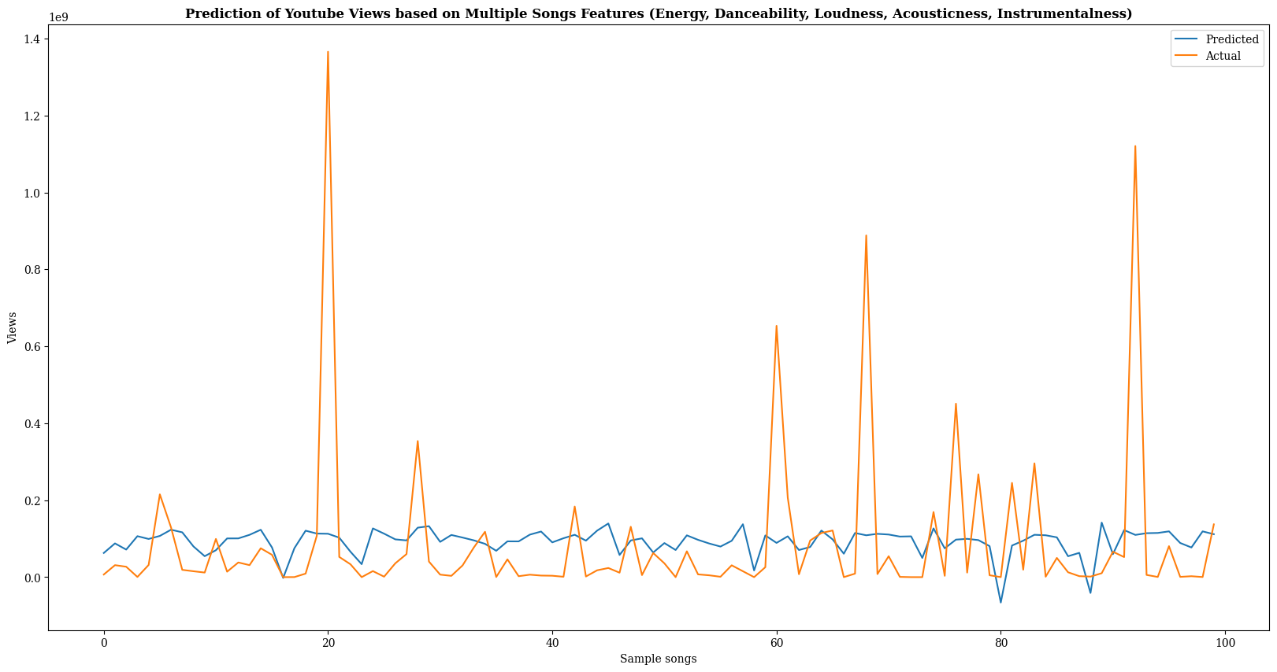
Prediction Modelling
02
Linear Regression
Notes:
Vy: within the samples (30%), 100 datapoints are taken to illustrate this graph

Slide 20
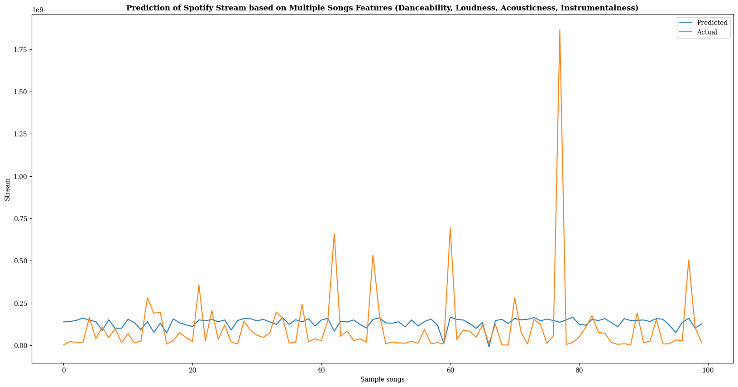
Prediction Modelling
02
Linear Regression
Notes:
Vy: within the samples (30%), 100 datapoints are taken to illustrate this graph

Slide 21
Prediction Modelling
02
Linear Regression
Reading the statistic of the two models, we can conclude that:
The prediction ability of YouTube model is around 1.4% and Spotify model is 1.3%. Both are low
The mean squared error values are both very high, meaning a high error values of predicted values compared to observed
The graphs also demonstrate that even though the models can make some predictions matching the test data, the accuracy is very low.

Slide 22
Conclusions
Ed Sheeran was the top Artist on YouTube, followed by CoComelon, a children's content channel.
On Spotify, Post Malone was the most successful Artist while Ed Sheeran ranked second.
These highlight differences in consumption trend of 2 platforms
Linear regression models built on song features (Danceability, Energy, and Loudness) exhibited low prediction
This implies that factors beyond these characteristics contribute more significantly to a song's popularity.
Challenges in accurately predicting licensed & unlicensed songs due to an imbalanced dataset
t-test confirmed a significant difference in audience engagement and consumption between 2 platforms.
Songs on Spotify had more views (59.5%) than on YouTube.
The presence of an official video significantly influenced a song's popularity.
Energy and loudness showed weak or no correlation with Spotify streams and YouTube views

Slide 23
Recommendations
Official content
Cross platform
Licenses
Continuously Analyze & Adapt
Official videos significantly influenced a song's popularity
Maximize their reach and exposure due to differences in consumption patterns
Licensing will allow for wider distribution and monetization
To effectively navigate the changing landscape and maximize chances of success
Diverse factors for popularity
Engagement metrics
International Markets
Balanced Dataset
Marketing, audience targeting, and promotion strategies, to enhance success
Correlations between views and likes indicate the importance of viewer engagement
Exploring international markets by capitalizing on the YouTube diverse global reach
Inclusive to enhance prediction model capacity & Avoid bias

Slide 24
References
Spotify and Youtube. (2023b, March 20). Kaggle. Retrieved on April 24, fromhttps://www.kaggle.com/datasets/salvatorerastelli/spotify-and-youtube
GeeksforGeeks. (2022). How to Find Drop duplicate columns in a Pandas DataFrame. GeeksforGeeks. Retrieved on April 24, from https://www.geeksforgeeks.org/how-to-find-drop-duplicate-columns-in-a-pandas-dataframe/
Zach. (2021). How to Drop Duplicate Columns in Pandas (With Examples). Statology. Retrieved on April 24, 2023 from https://www.statology.org/pandas-drop-duplicate-columns/
Merge, join, concatenate and compare — pandas 2.0.1 documentation. (n.d.). Retrieved on April 24, 2023 from https://pandas.pydata.org/docs/user_guide/merging.html
Kleppen, E. (2023, April 5). How To Find Outliers in Data Using Python (and How To Handle Them). CareerFoundry. Retrieved on April 24, 2023 from https://careerfoundry.com/en/blog/data-analytics/how-to-find-outliers/
Stack Overflow. Compare two lists in python and return matches. (n.d.). Retrieved on April 24, 2023 from https://stackoverflow.com/questions/1388818/how-can-i-compare-two-lists-in-python-and-return-matches
Northeastern University, ALY6015 - Intermediate Analytics (2023). Retrieved on April 24, 2023.
Python, R. (2022). Logistic Regression in Python. realpython.com. https://realpython.com/logistic-regression-python/#:~:text=The%20logistic%20regression%20function%20%F0%9D%91%9D(%F0%9D%90%B1)%20is%20the%20sigmoid%20function,that%20the%20output%20is%200.
GeeksforGeeks. (2022b). Create a correlation Matrix using Python. GeeksforGeeks. https://www.geeksforgeeks.org/create-a-correlation-matrix-using-python/
GeeksforGeeks. (2023a). Linear Regression Python Implementation. GeeksforGeeks. https://www.geeksforgeeks.org/linear-regression-python-implementation/
Narkhede, S. (2021, June 15). Understanding Confusion Matrix - Towards Data Science. Medium.https://towardsdatascience.com/understanding-confusion-matrix-a9ad42dcfd62
PyCoach. (2022b, January 4). A Simple Guide to Linear Regression using Python - Towards Data Science. Medium. https://towardsdatascience.com/a-simple-guide-to-linear-regression-using-python-7050e8c751c1
sklearn.linear_model.LogisticRegression. (n.d.). Scikit-learn. https://scikit-learn.org/stable/modules/generated/sklearn.linear_model.LogisticRegression.html
GeeksforGeeks. (2021a). Bar Plot in Matplotlib. GeeksforGeeks. https://www.geeksforgeeks.org/bar-plot-in-matplotlib/
Matplotlib Pie Charts. (n.d.). https://www.w3schools.com/python/matplotlib_pie_charts.asp
Scatter plot — Matplotlib 3.7.1 documentation. (n.d.). https://matplotlib.org/stable/gallery/shapes_and_collections/scatter.html

Slide 25

Thank you !

